Slide 1

AI编译器系列
编译器的发展
ZOMI

Slide 2
About 关于本内容
传统编译器
History of Compiler - 编译器的发展
GCC process and principle – GCC 编译过程和原理
LLVM/Clang process and principle – LLVM 编译过程和原理
AI编译器
History of AI Compiler – AI编译器的发展
Base Common architecture – AI编译器的通用架构
Different and challenge of the future – 与传统编译器的区别，未来的挑战与思考

Slide 3
两大开源编译器的
相爱与相杀

Slide 4
两大开源编译器的
恩怨情仇

Slide 5
What is Compiler 编译器是什么
In computing, a compiler is a computer program that translates computer code written in one programming language into another language. The name "compiler" is primarily used for programs that translate source code from a high-level programming language to a lower level language to create an executable program.

Slide 6
Compiler basic constitution 编译器基本构成

Slide 7
Compiler basic constitution 编译器基本构成
Front-End：主要负责词法和语法分析，将源代码转化为抽象语法树；

Slide 8
Compiler basic constitution 编译器基本构成
Optimizer：优化器则是在前端的基础上，对得到的中间代码进行优化，使代码更加高效；

Slide 9
Compiler basic constitution 编译器基本构成
Back-end：后端则是将已经优化的中间代码转化为针对各自平台的机器代码；

Slide 11
GNU Compiler Collection, GCC
first released in 1987 by Richard Stallman, GCC 1.0 was named the GNU C Compiler since it only handled the C programming language.
The GNU Compiler Collection (GCC) is an optimizing compiler produced by the GNU Project supporting various programming languages, hardware architectures and operating systems.

Slide 12
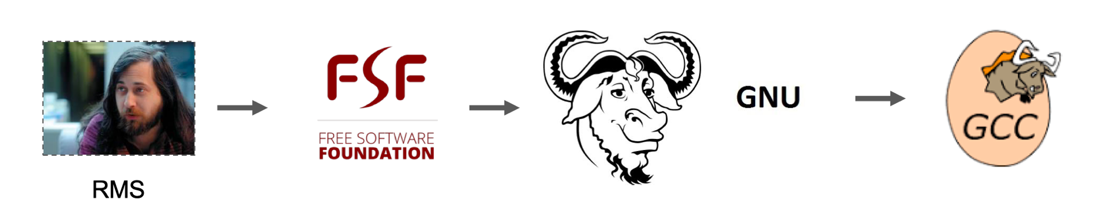
GNU Compiler Collection, GCC
GNU Compiler Collection
(GNU C Compiler)
Richard M. Stallman
GNU's Not Unix!

Slide 13
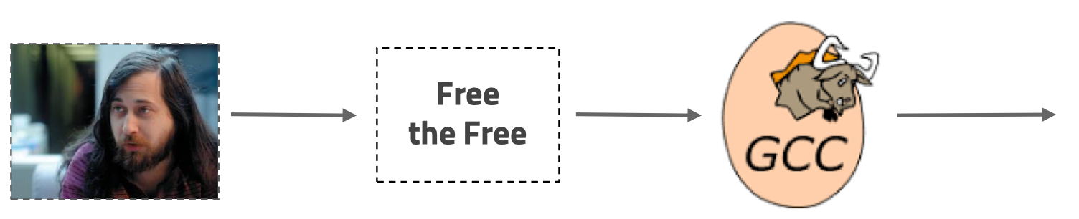
GNU Compiler Collection, GCC
Open Source Project

Slide 14
Apple

Slide 15
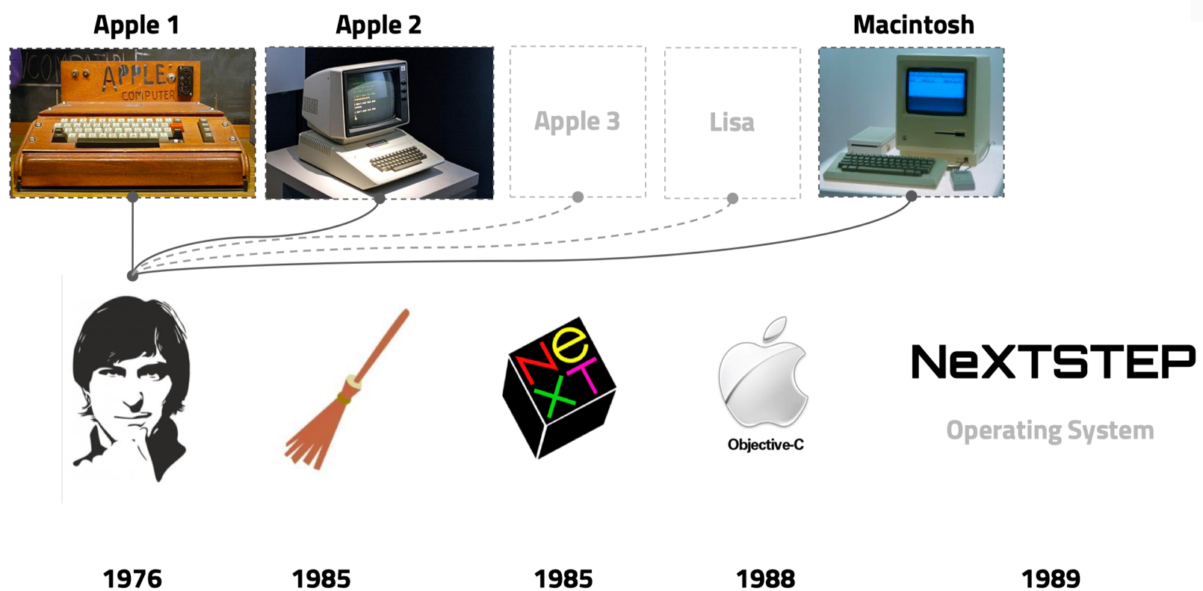
Apple Computer & NeXT

Slide 16
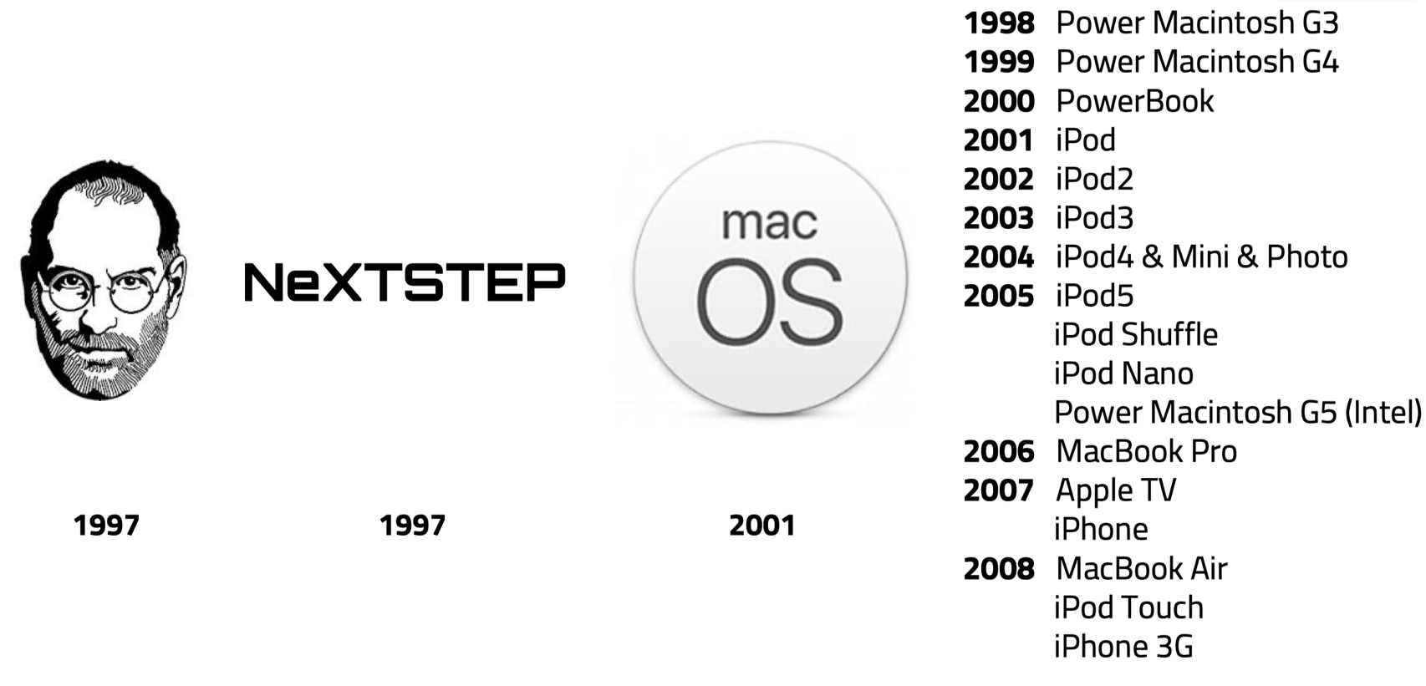
Apple Computer & NeXT

Slide 17
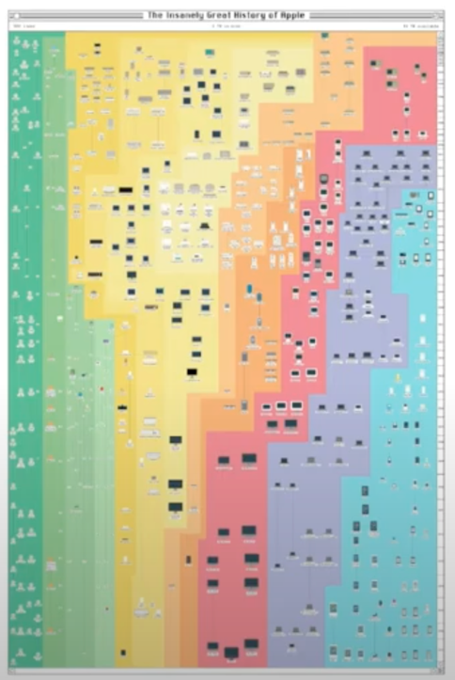
Complicate Ecosystem
CPU | OS | Language
ARMv6 | macOS | C
ARMv7 | iOS | C++
ARMv8 | watchOS | Objective-C
Intel X86 | tvOS | Swift
PowerPC

Slide 18
Complicate Ecosystem

Slide 19
Apple needs find a way out
GCC is developed for solving real problems,
it has no time to make a good everything perfect.

Slide 20


Apple met LLVM
Chris Lattner
Twitter: https://twitter.com/clattner_llvm
Website: http://nondot.org/sabre

Slide 21
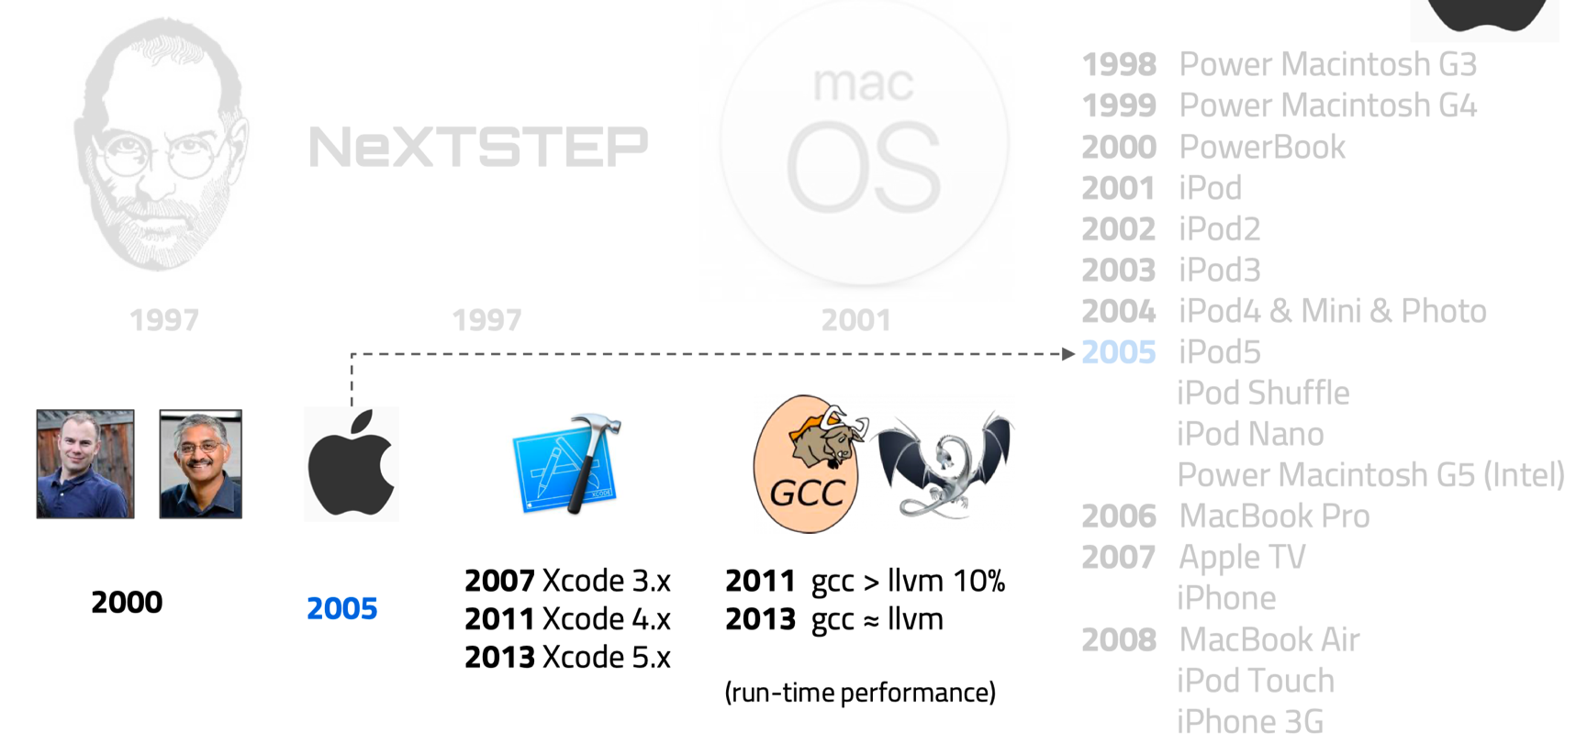
Apple met LLVM

Slide 22
Microsoft

Slide 23
Microsoft

Slide 24
Notes:
24

